Slide 1
ELEVATE LABS TASK 6
Nazim Atakan Erdogan

Slide 2
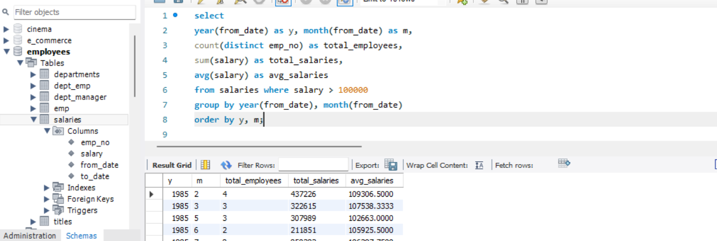
Using ‘Employees’ database, calculating avg and total salaries per month and year who have a salary greater than 100000$ per year

